Slide 1


Group 10
Capstone Project Report
Blockchain News Aggregator

Slide 2

Introduction
The goal of the project is to develop a comprehensive system primarily focused on news related to the blockchain field.
The system uses data from various English-language sources, including news websites, blogs, and articles, providing valuable insights into the blockchain industry.
After the data is gathered, it is stored, and users can quickly access relevant content through a sophisticated search engine.
Python will be used for the search algorithm because of its rich data processing libraries.
To ensure seamless integration, Java and Python components will communicate via RESTful API, ensuring efficient data exchange and analysis.
To further assist users, JavaSwing and NetBeans are implemented to create an interactive user interface.

Slide 3





Task assignments & Contribution
Le Minh Hai
Vu Quoc Dung
Trieu Kinh Quoc
Vu Duc Minh
Tran Khoi Nguyen
Data Collection & Classification
Search Engine Algorithm
Front-end & Back-end
API Connection
Data Collection & Classification

Slide 4
DATA ANALYSIS
Our article database contains 5516 articles collected from various trustworthy blockchain news platforms and aggregators.
The articles are stored in JSON format for easier, lightweight parsing (for computers) and checking (for humans).
Each article is accompanied by the following attributes:
websiteSource: The source of the collected article.
type: The type (format) of the article (News, Blog, Article).
title: The title of the article.
category: The category of the article, or the main topic/tags mentioned inside the article.
author: The author(s) of the article.
link: The direct link to the article on the source website.
creationDate: The date (in MMMM dd, yyyy format) the article was published.
content: The full detailed content of the article.
referenceLinks: Highlighted keywords/parts in the article that redirect users to other websites.
pictureLink: A direct link to the accompanying picture, which provides a more illustrative experience.

Slide 5

DATA ANALYSIS
An example of an accompaniment picture.
This part provides the direct link to that picture, serves mainly for a more illustrative experience.

Slide 6
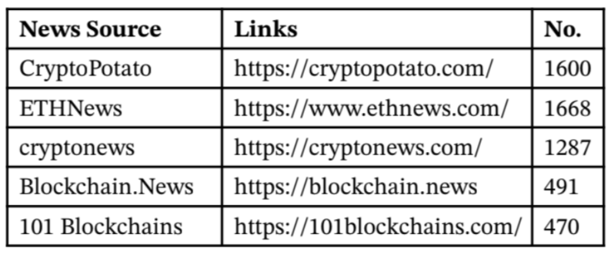
websiteSource
type
Our content mainly comprises three types: News, Articles, and Blogs from the mentioned news sources. We aim to extend our article variety to include Facebook posts, Tweets, etc., but data privacy policies prevent this. This attribute will be considered when users explicitly search for specific types of articles.
content and title
The content and title are directly related within the scope of the article. The search engine algorithms compute the frequency of keywords in both the article and the title. These frequencies are compared with users' queries to provide the closest result.

Slide 7
UML DIAGRAM
The complete UML diagram is complex and multi-tiered. A partial example is provided below for illustrative purposes. The comprehensive use case diagram is available through the Astah file in our designated Drive folder.

Slide 8
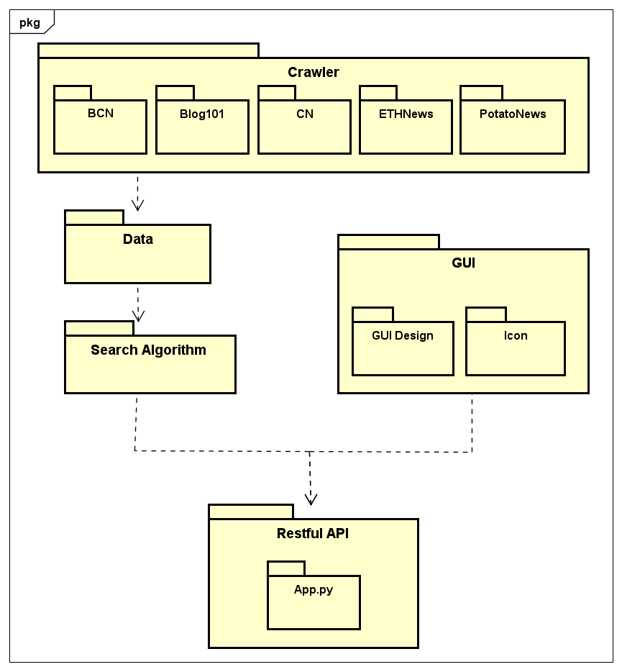
Package dependency diagram

Slide 9
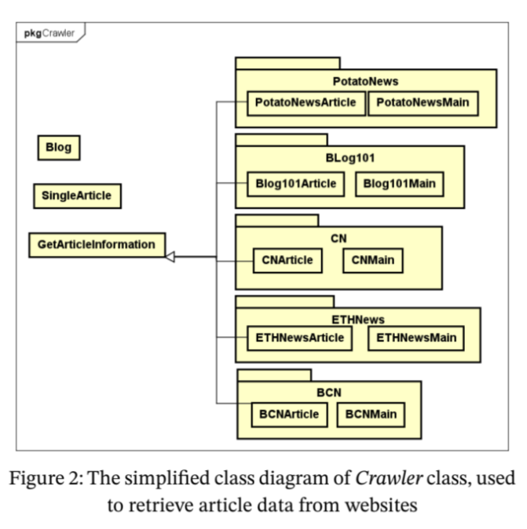
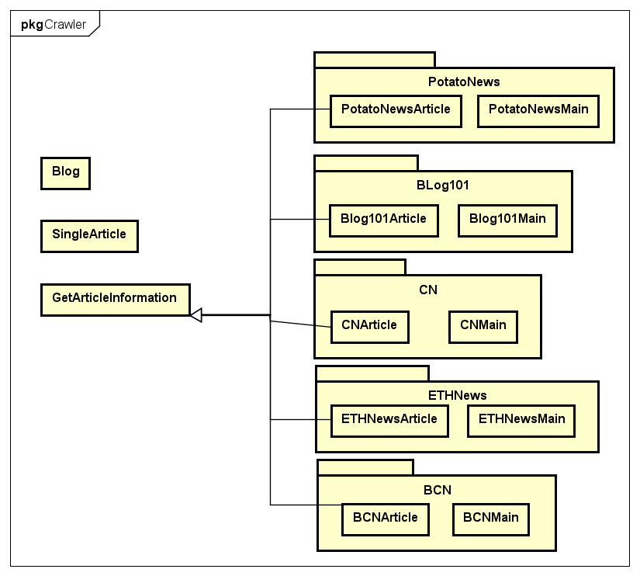

Slide 10
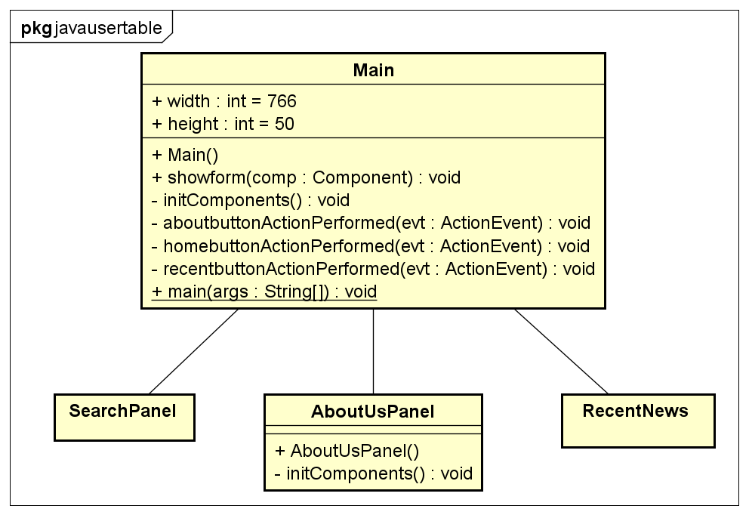
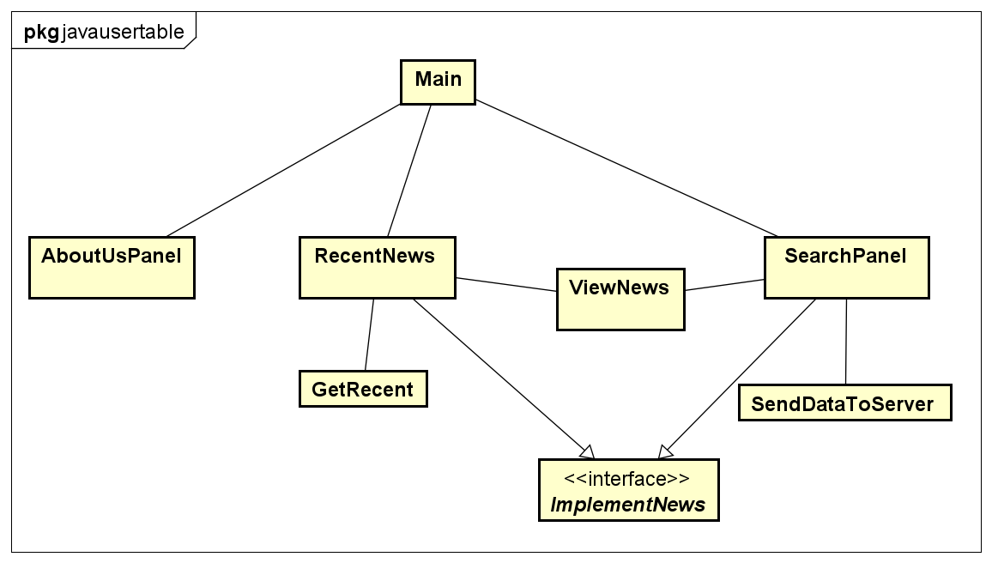
The class diagram of JavaUserTable class, used to display the Main Frame
The class diagram of JavaUserTable class, used to display the User Interface

Slide 11
PROJECT DESIGN ANALYSIS
Libraries
The data collection process in this project involved two key components: the Jsoup library for retrieving HTML con- tents and the Gson library for collecting the data into JSON files.
LIBRARIES
METHODS
Jsoup for HTML Content Retrieval:
To retrieve HTML contents from various sources, we utilized the Jsoup library.
Jsoup is a popular Java library for efficiently parsing HTML documents, extracting specific elements, and retrieving their contents.

Slide 12
Gson for Data Serialization to JSON
To store the collected data in a structured format, we used the Gson library for serializing Java objects into JSON.
Gson, developed by Google, provides simple APIs for converting Java objects to JSON representations and vice versa.

Slide 13
Packages, Classes & Dependencies
The following analysis presents an overview of the classes utilized in our implementation, along with the object-oriented programming (OOP) techniques employed within each class.

Slide 14

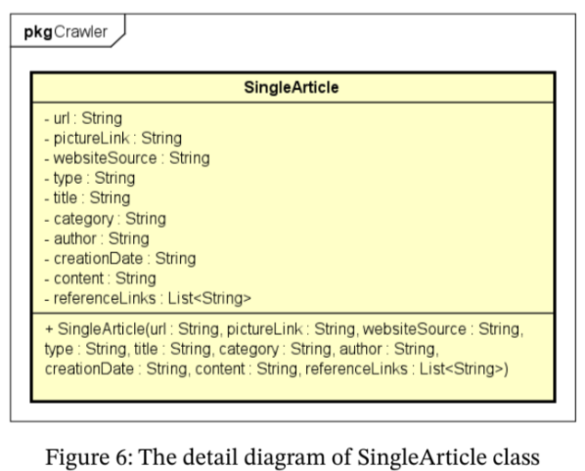
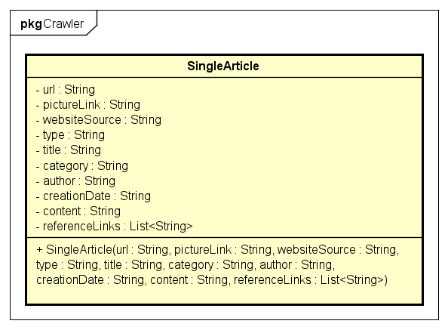
Crawler package
SingleArticle class
The SingleArticle class represents a single article object and encapsulates its information:
Attributes include: websiteSource, type, title, category, author, link, creationDate, content, referenceLinks, pictureLink.
By making the attributes private and providing getter methods, the class promotes controlled access to the article’s information and encapsulates its internal representation.
The constructor of SingleArticle initializes the attributes based on the provided arguments, ensuring that the article object is created in a valid state.

Slide 15
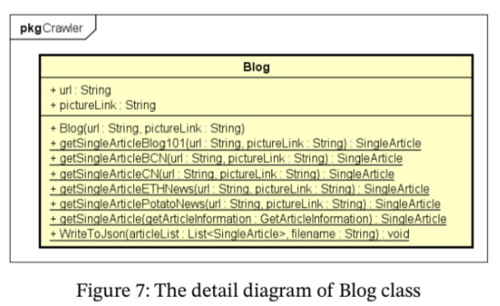
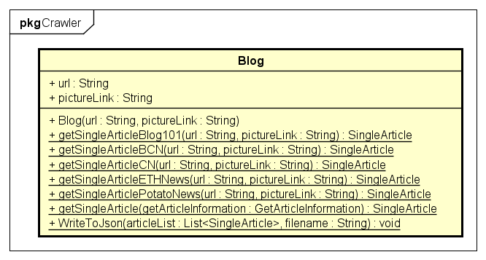
Crawler package
Blog class
The Blog class acts as a utility class for retrieving and processing articles from various sources, using static methods for convenience and reusability without needing object instantiation.
The class showcases polymorphism by accepting different implementations of the GetArticleInformation class as arguments in its static methods. This allows it to handle articles from different sources by relying on the implementations provided by the subclasses of GetArticleInformation.
The getSingleArticle() method demonstrates the use of composition by accepting a GetArticleInformation object and converting it into a SingleArticle object, encapsulating the article information into a unified representation.
The WriteToJson() method uses the Gson library to convert a list of SingleArticle objects into JSON format and writes it to a file.

Slide 16
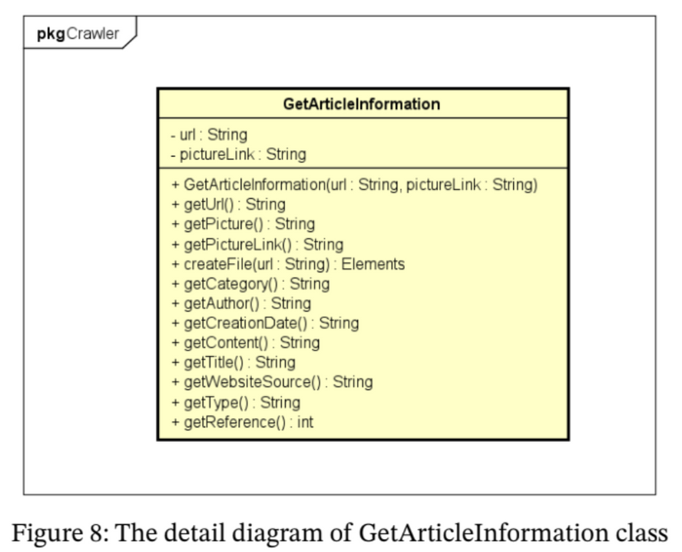
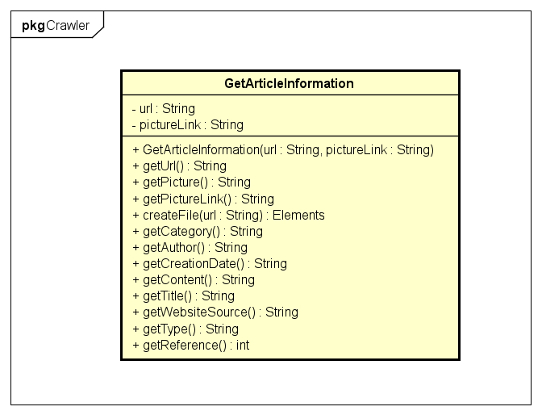
Crawler package
GetArticleInformation class
This class serves as a base for implementing article-specific information retrieval classes.
It demonstrates the use of abstraction by defining a common interface and abstract methods that subclasses need to override.
The class defines abstract methods for retrieving information such as URL, picture link, category, author, creation date, content, title, website source, type, and reference links. This allows subclasses to provide specific implementations based on the article source they are designed for.
The class provides the interface for retrieving article information, allowing for polymorphic behavior when working with different article sources.

Slide 17


BCNArticle class
The class represents an article retrieved from the BCN website.
It extends the GetArticleInformation class, showcasing the use of inheritance. By extending the base class, BCNArticle inherits its attributes and methods, allowing code reusability.
The class provides specific implementations for methods defined in the base class to extract information specific to BCN articles, such as type, category, author, creation date, content, and reference links.
BCNArticle also defines methods to retrieve the website source and the article’s picture link.

Slide 18
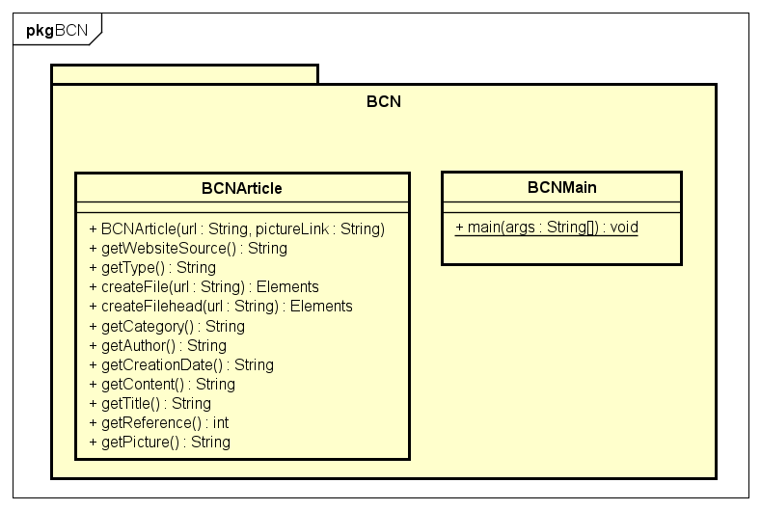
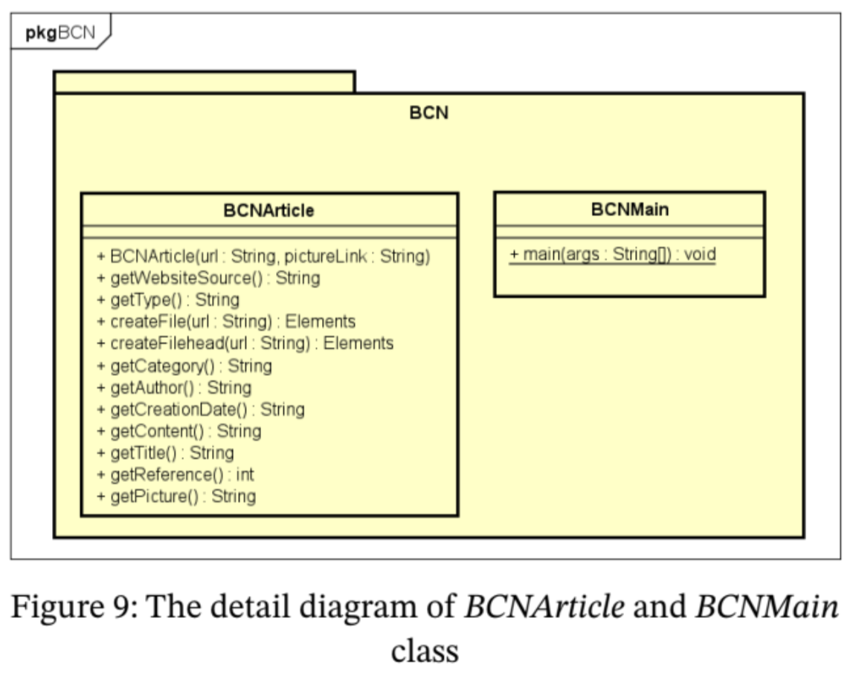
BCNMain class
The BCNMain class serves as the entry point of the program and is responsible for crawling articles from the BCN website.
It demonstrates the use of composition by utilizing instances of the BCNArticle and Blog classes to retrieve and process individual articles.
It utilizes the Jsoup library to fetch article information from the BCN website

Slide 19
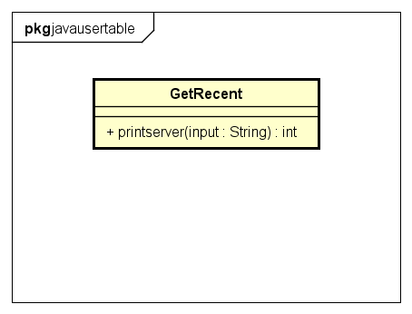
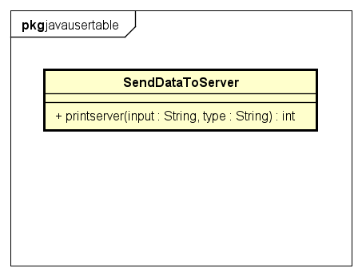
USER INTERFACE PACKAGES & CLASSES
Using GUI is Java Swing - part of Java Foundation Classes (JFC), which provides a set of tools for creating graphical user interfaces (GUI) in Java applications.
Use 2 classes to call the API
SendDataToServer()
GetRecent ()
This class serves as an activation for the 'POST' method, updating user information (including entered keywords and desired category) to the server at http://localhost:5000/data. It takes in user input and category to provide article results.
The class then activates the 'GET' method to retrieve information about the most relevant articles in the form of a JSONArray from the algorithm in our search engine.
This class activates the 'POST' method, updating user information (desired category) to the server at http://localhost:5000/recent. It only takes in categorical input (change in the Category bar).
From there, this class activates the 'GET' method to retrieve information about the most recent articles in the form of a JSONArray from the algorithm in our search engine.

Slide 20
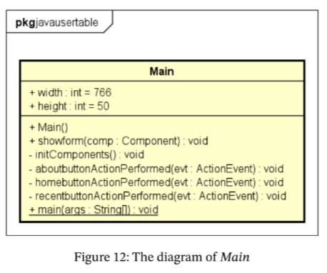
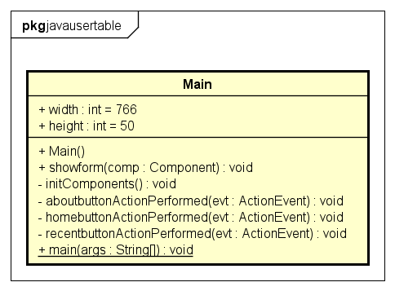
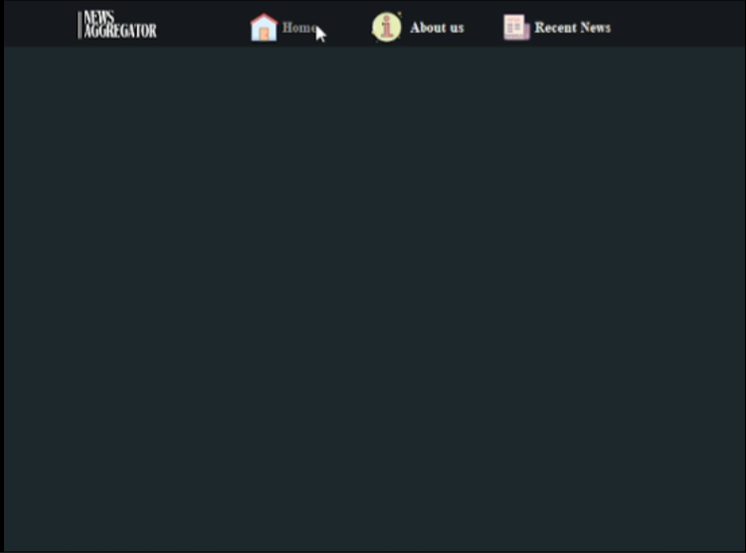

MAIN CLASS
jcomponents of frame:
Homebutton (jButton): function homebuttonActionPerformed calls jPanel searchPanel
Aboutbutton (jButton): function aboutbuttonActionPerformed calls jPanel AboutUsPanel
recentbutton (jButton): function recentbuttonActionPerformed calls jPanel recentnews

Slide 21
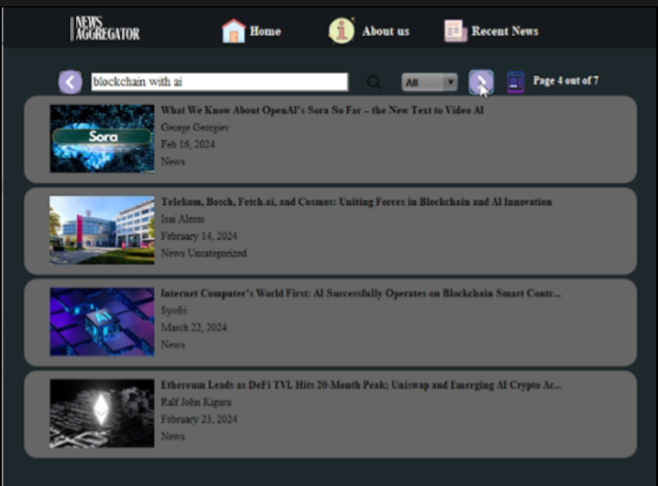
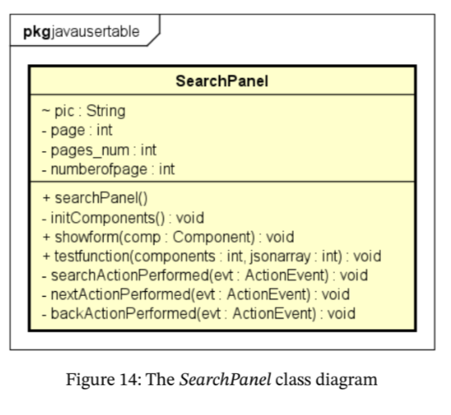
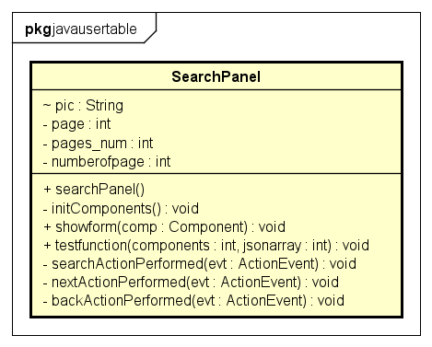
jPanels support jButton operations
SearchPanel:
SearchPanel displays the search interface. Because we receive many keyword-related articles from the algorithm, SearchPanel needs to support navigation between pages

Slide 22
jComponents :
searchbar (jTextField): Receives keywords from users.
back (jButton): Moves to the previous set of 4 articles.
next (jButton): Moves to the next set of 4 articles.
search (jButton): Performs search. Calls the searchActionPerformed function to activate the sendDataToServer() function to retrieve the most relevant articles.
Categorycombobox (jComboBox): Receives a selection of one of three types (All, Article, Blog, News) from the user to facilitate search by types.
Currentpage (jLabel): Displays the current page of articles.
News1, News2, News3, News4 (jPanel): Helps display the current articles of the page. Each panel includes:
image (jLabel): Displays the article image.
title (jLabel): Displays the article title. Activates the ViewNews() function to display the full article to the user.
author (jLabel): Displays the author of the article.
subtitle (jLabel): Displays the posting date of the article.
type (jLabel): Displays the associated category of the article.

Slide 23
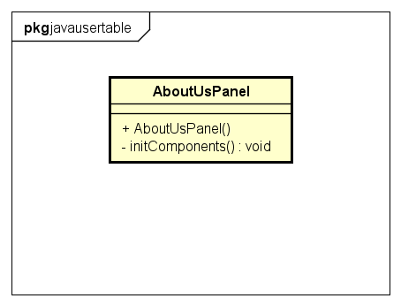
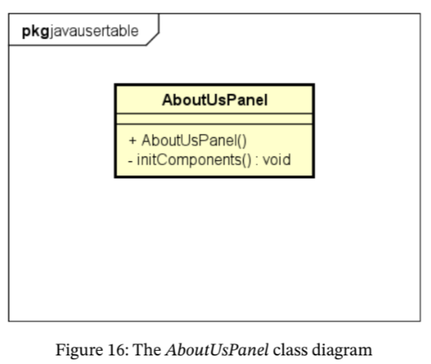
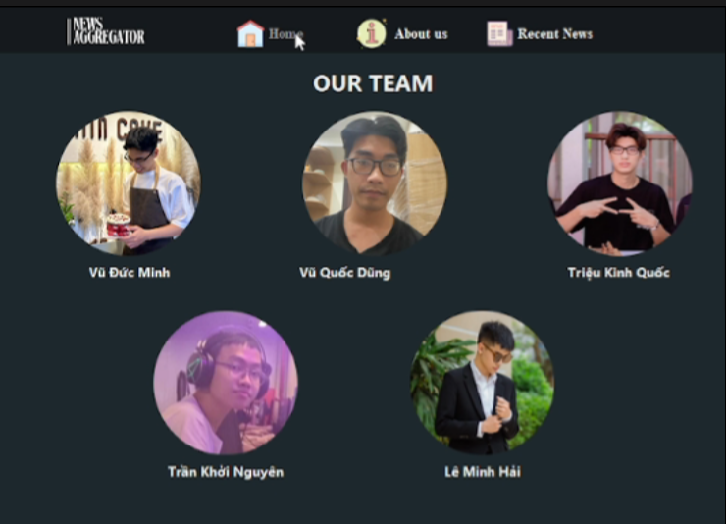
AboutUsPanel
The jComponent :
Image (jLabel): image of each member
Name (jLabel): name of each member
Role (jLabel): image of each member

Slide 24
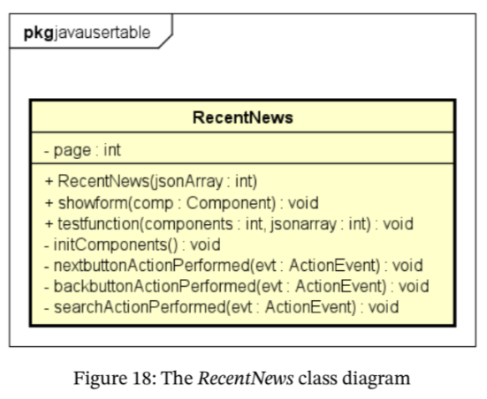
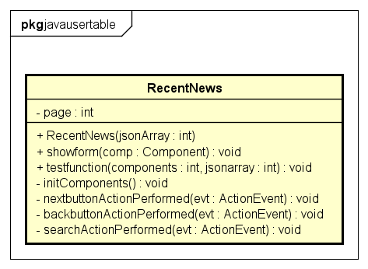
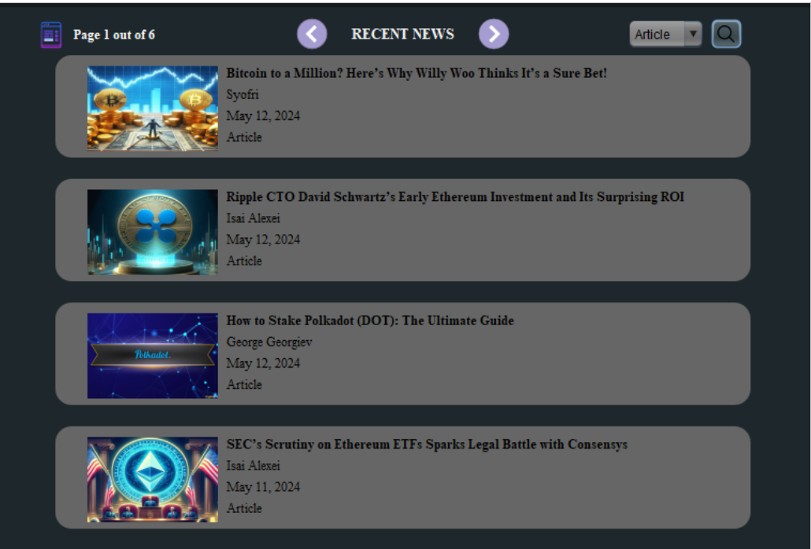
RecentNews (jPanel):
RecentNews displays the most recent articles based on the category we desire. Recentnews can display many recent articles, so this panel needs to support navigation between pages
RecentNews includes the following notable jComponents:
Backbutton (jButton): supports moving to the previous page
Nextbuton(jButton): supports moving to the next page
Currentpage(jLabel): displays the current page number out of the total number of pages
Categorycombobox (jComboBox): supports category selection from users
Search (jButton): starts searching for the most recent articles by category from the user. Search has a callback function searchActionPerform that calls the getrecent() function in the getrecent class.

Slide 25
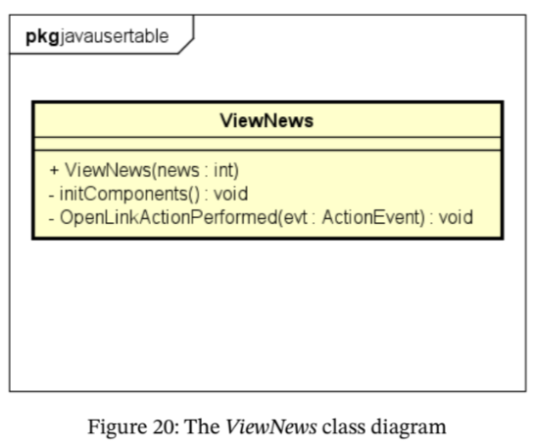
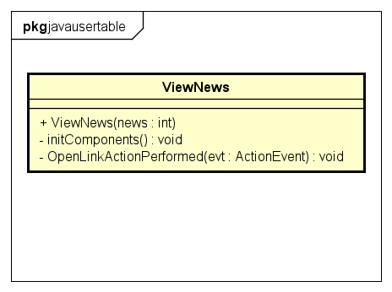
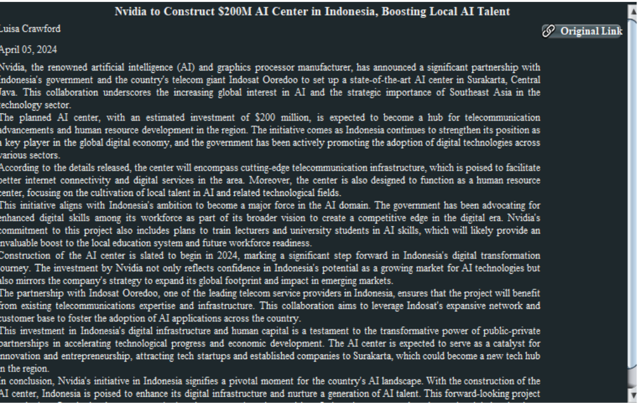
ViewNews
This jPanel will display articles for users to read. ViewNews includes the following jComponents:
Title (jLabel): displays the article's interface
Author (jLabel): displays the author of the article
Date (jLabel): displays the publish date of the article
OpenLink (jButton): with ActionPerform function, opens the original link.

Slide 26
RESTful API
This Flask API serves as a web-based interface that enables users to perform searches for related articles and retrieve recent articles. It consists of two main servers: "/data" and "/recent", each serving a distinct purpose in the information retrieval process.
The "/data" server returns the most relevant articles based on user-defined keywords and category. The payload for this server is a JSON file containing the input keyword and category for the search. Upon receiving the payload, the server processes the request and returns a symbolic JSON object containing the search results.
The "/recent" server retrieves the most recent articles. The payload for this server includes the category for the search. When the server receives the payload, it fetches the most recent articles within the specified category. Then, it returns a JSON object containing the search results, providing users with access to the latest articles in their desired category.

Slide 27
BM25 algorithm and PageRank
In information search, Okapi BM25 is a ranking function used by search engines to rank documents according to their relevance to a given query. This ranking function is based on a probability model, a method called BM25 (BM – best match). Basically, BM25 is a widely used ranking method in search based on keyword relevance.
PageRank is used by the Google search engine to determine the importance of a web page based on the number and quality of incoming links, independent of search keywords. The basic idea of PageRank is to consider each web page as a node in a graph, with links between web pages represented by the edges of the graph. Accordingly, a website with many links from other websites will be considered more important.

Slide 28



Thank You
For Your Attention

